Slide 1

Statistical Analysis
PCA(Principle components Analysis)
Sheeba Javed
Project;Overview: I used my knowledge of statistical analysis and my skill with R programming to do a thorough investigation of intricate datasets through the application of Principal Component Analysis (PCA). I successfully decreased dimensionality while maintaining crucial information by utilizing PCA, which allowed for perceptive readings of the underlying data structures and linkages. I offered practical insights for well-informed decision-making through meticulous statistical testing and visualization approaches. This research demonstrates my command of statistical procedures and my capacity to use sophisticated R analytical tools to extract insightful information from data.

Slide 2
PCA Analysis (Wine Data)
# Required library(FactoMineR)
# Import dataset from the provided URLwine <- read.table("https://rdrr.io/cran/FactoMineR/man/wine.html", header = TRUE)
# Load the wine datasetdata(wine)
# Display the first few rows of the datasethead(wine)
wine_data <- wine[,c(1,11,13,22,24,26,27,28,29,30)]
head(wine_data)
data(wine)
dim(wine)

Slide 3
Principal Component Analysis (PCA) for Multi-dimensional Appling PCA(pc1,pc2,pc3,pc4)
head(wine_data)
wine_pca <- prcomp(wine_data[,-1],
scale=TRUE)
PC <- as.data.frame(wine_pca$x)
head(PC)PC$Label<-
wine_data$Labelplot(PC$PC1, PC$PC2,
col = PC$Label,
pch = 19,
main="Figure 1: 2D Scatterplot",
xlab="PC1",
ylab="PC2")
legend("bottomright", legend = levels(PC$Label), col = seq_along(levels(PC$Label)), pch = 19)

Slide 4
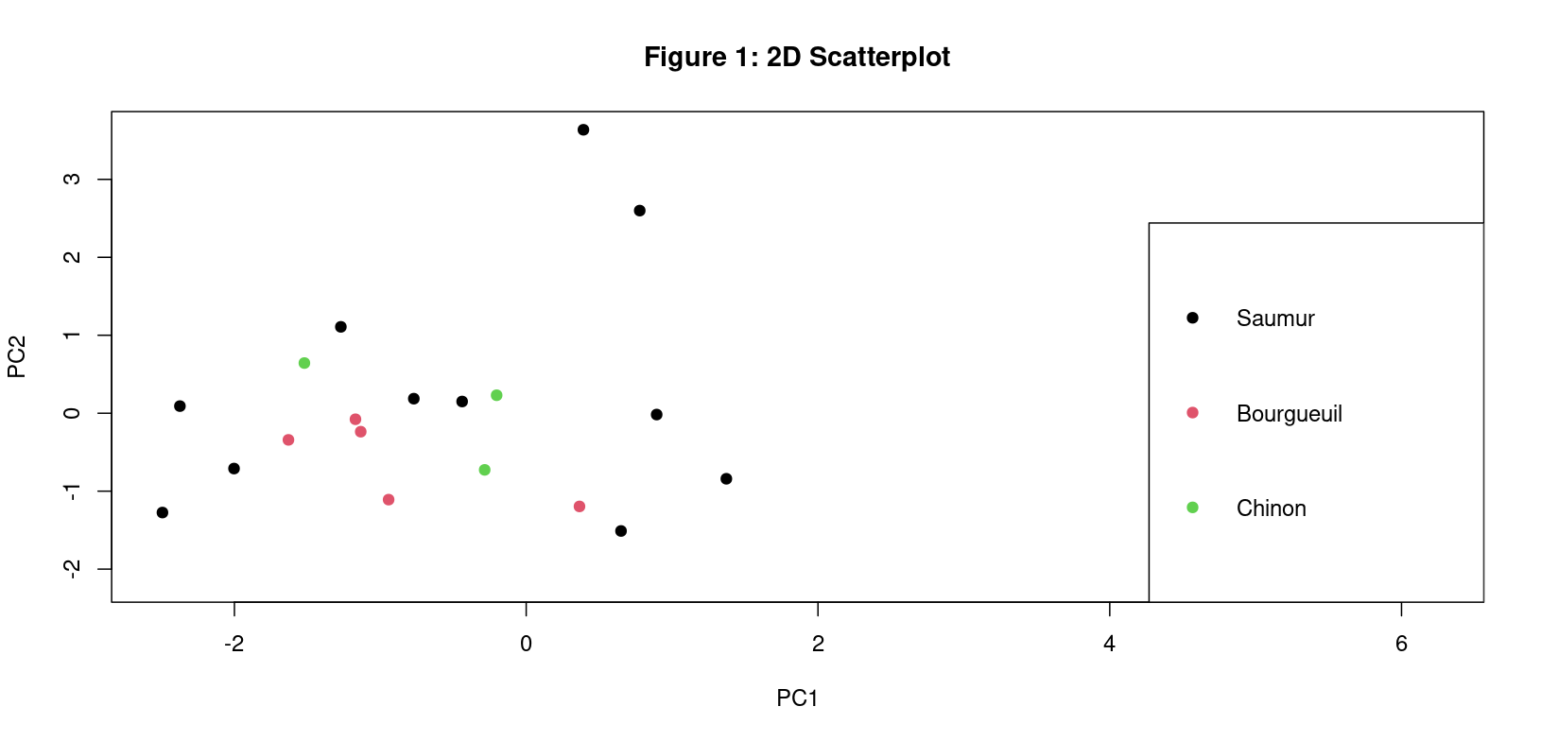

Slide 5
Ellipse plot(PC1 & PC2)
legend("bottomright",
legend = levels(PC$Label),
col = seq_along(levels(PC$Label)),
pch = 19)
ggplot(PC,
aes(x = PC1,
y = PC2,
color = Label)) +
geom_point() +
scale_color_manual(values=c("blue", "#CC0066", "black")) +
stat_ellipse() + ggtitle("Figure 2: Ellipse Plot") +
theme_bw()

Slide 6
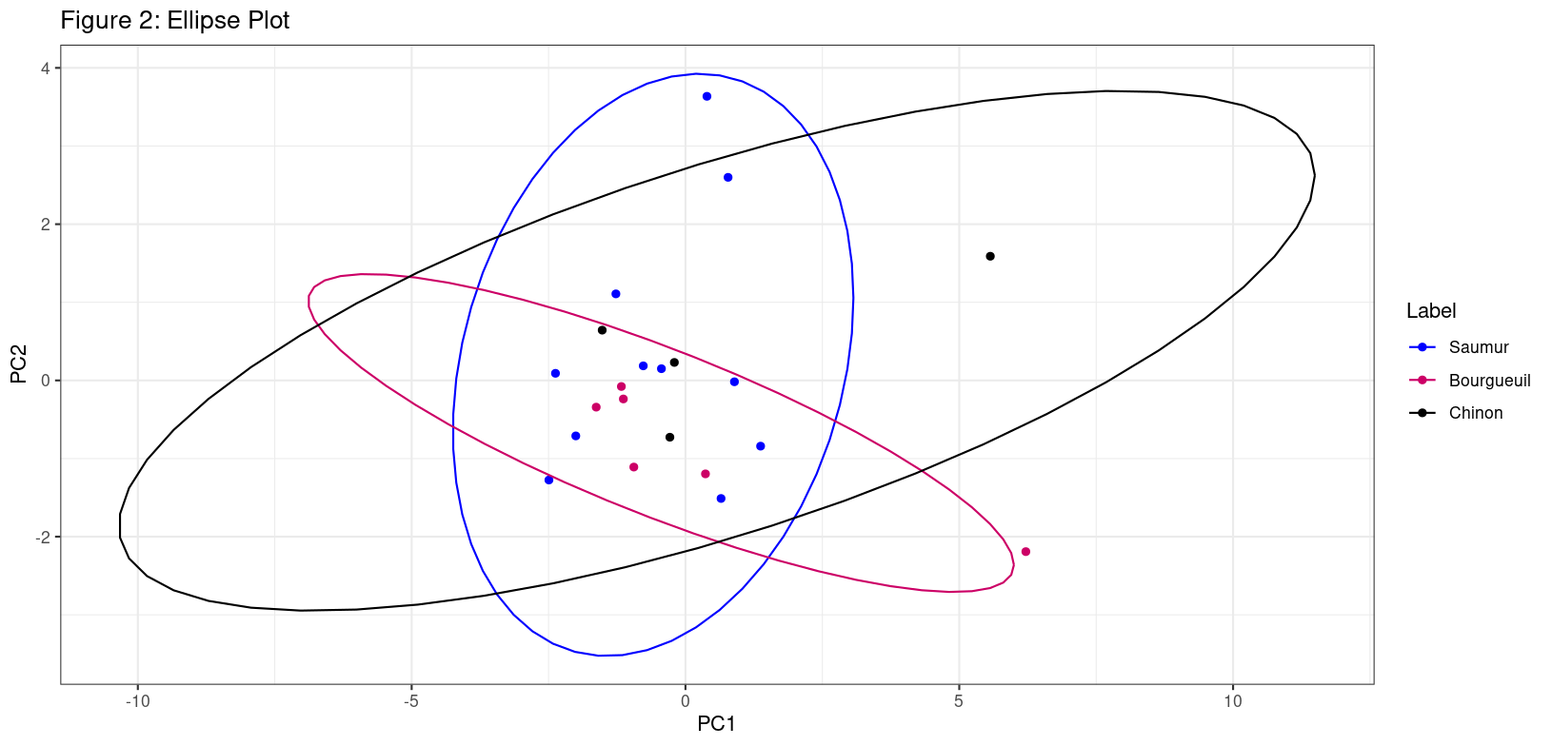

Slide 7
3D plot(PC1 & PC2 )
plot_3d <- with(PC,
scatterplot3d(PC$PC1,
PC$PC2,
PC$PC3,
color = as.numeric(Label),
pch = 19,
main ="Figure 3: 3D Scatter Plot",
xlab="PC1",
ylab="PC2",
zlab="PC3"))
legend(plot_3d$xyz.convert(0.5, 0.7, 0.5), pch = 19, yjust=0, legend = levels(PC$Label),
col = seq_along(levels(PC$Label)))

Slide 8
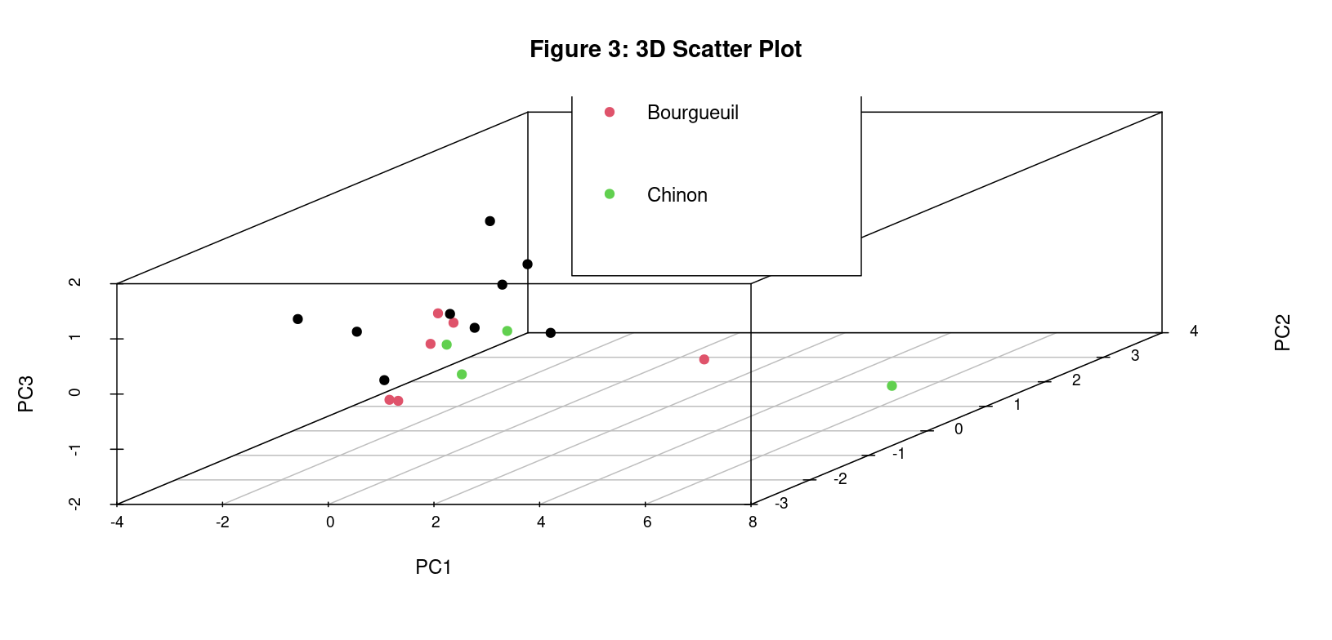

Slide 9
Biplot(PC1 & PC2)
fviz_pca_biplot(wine_pca,
repel = TRUE,
col.var = "blue",
title = "Figure 4: Biplot", geom="point")

Slide 10
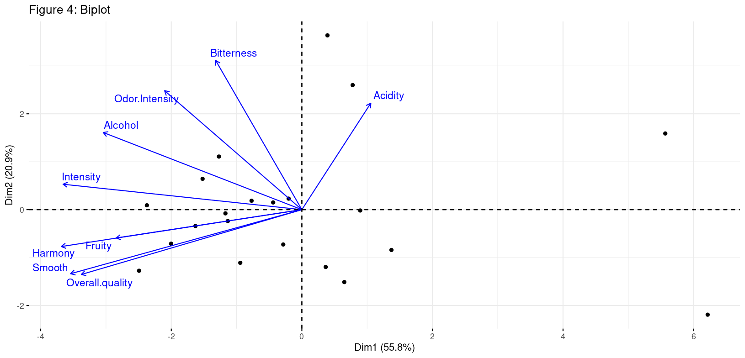

Slide 11
Scree plot(pc1 & pc2)
fviz_eig(wine_pca,
addlabels = TRUE,
ylim = c(0, 70),
main="Figure 5: Scree Plot")

Slide 12
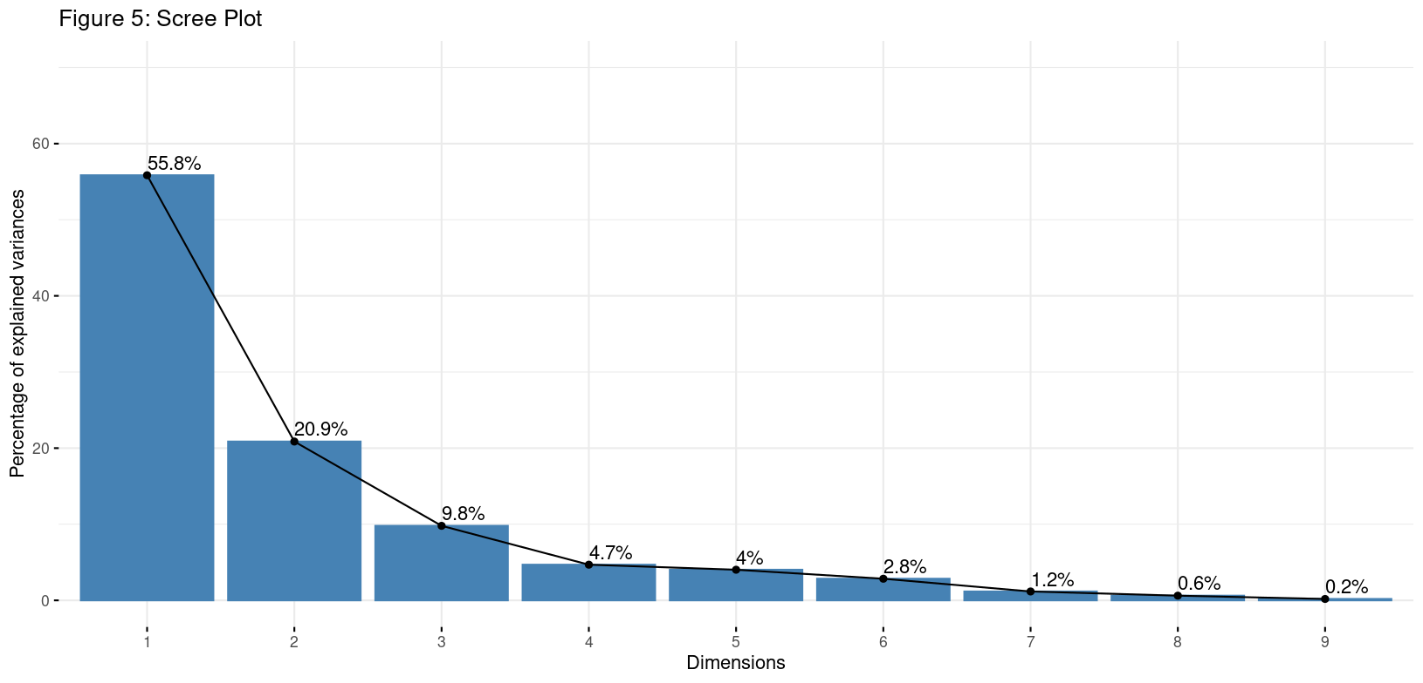

Slide 13
Principal Components Analysis(pc3 & pc4)
PC$Label<-wine_data$Label
PC$PC3<-wine_data$Odor.Intensity
Wine_pca <- prcomp(win_data[,0],
scale=TRUE)
PC <- as.data.frame(wine_pca$x)
head(PC)
plot(PC$PC3,
PC$PC4,
col = PC$Labe2,
PC <- as.data.frame(wine_pca$x)
PC$Label <- wine_data$Label

Slide 14
Scatter plot(pc3 & pc4)
## 2D Scatterplot
plot(PC$PC3,
PC$PC4,
col = c("red", "green", "blue")[as.numeric(PC$Label)],
pch = 19,
main = "Figure 1: 2D Scatterplot (PC3 vs PC4)",
xlab = "PC3",
ylab = "PC4")
legend("bottomright",
legend = levels(PC$Label),
col = c("red", "green", "blue"),
pch = 19)

Slide 15
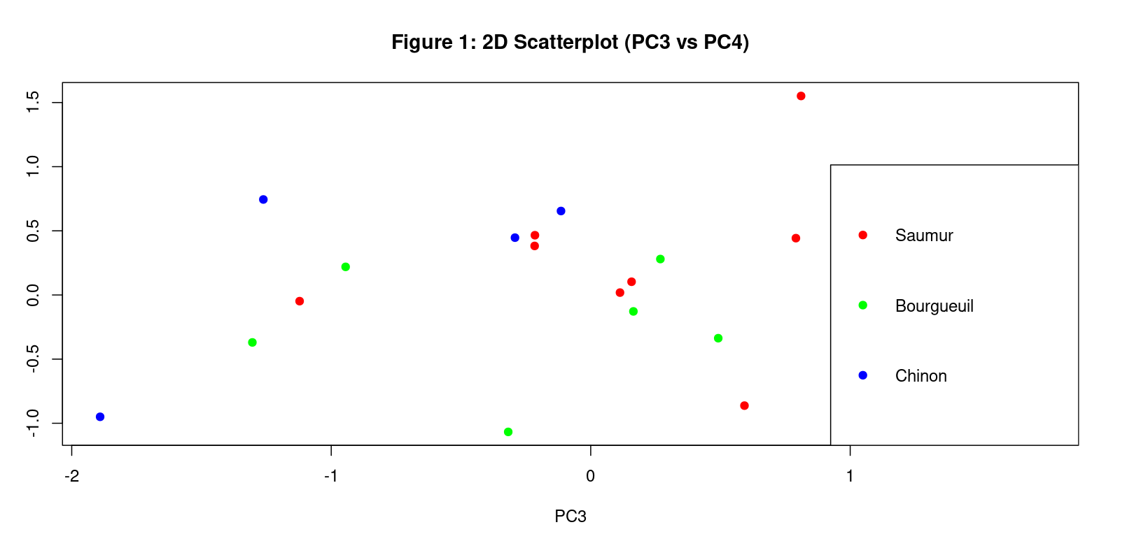

Slide 16
Ellipse plot(pc3 & pc4)
## Ellipse Plot
library(RColorBrewer)
palette <- brewer.pal(n = 3, name = "Set2")
ggplot(PC,
aes(x = PC3,
y = PC4,
color = Label)) +
geom_point() +
scale_color_manual(values = palette) +
stat_ellipse() +
ggtitle("Figure 2: Ellipse Plot (PC3 vs PC4)") +
theme_bw()

Slide 17
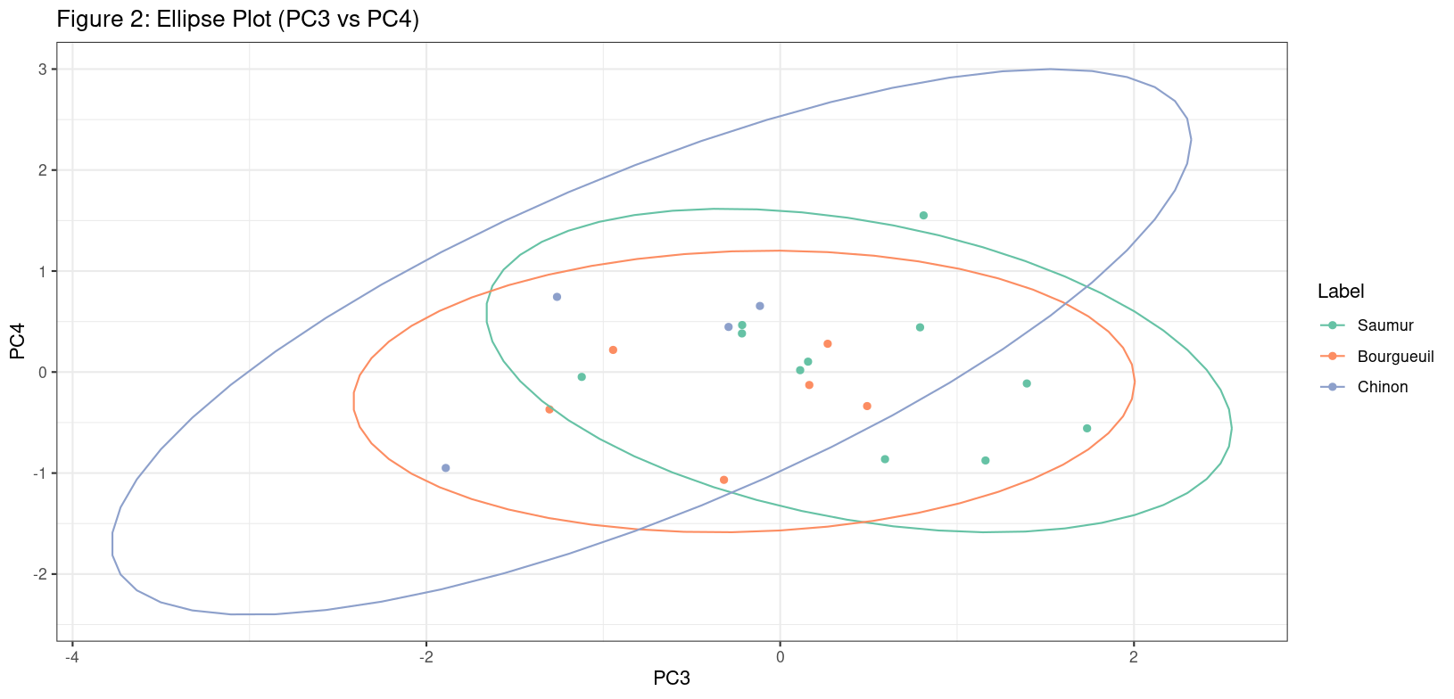

Slide 18
3D Scatterplot(pc3 & pc4)
plot_3d <- with(PC,
scatterplot3d(PC$PC3,
PC$PC4,
PC$PC1,
color = as.numeric(Label),
pch = 19,
main = "Figure 3: 3D Scatter Plot (PC3 vs PC4 vs PC1)",
xlab = "PC3",
ylab = "PC4",
zlab = "PC1"))
legend(plot_3d$xyz.convert(0.5, 0.7, 0.5),
pch = 19,
yjust = 0,
legend = levels(PC$Label),
col = seq_along(levels(PC$Label)))

Slide 19
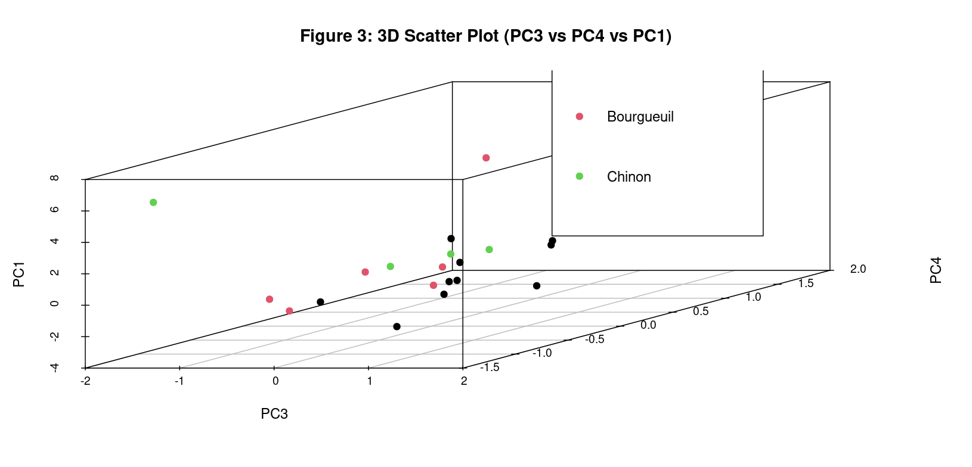

Slide 20
Biplot(pc3 & pc4)
fviz_pca_biplot(wine_pca,
choices = c(3, 4),
repel = TRUE,
col.var = "red",
title = "Figure 4: Biplot (PC3 vs PC4)",
geom = "point")

Slide 21
